Slide 1
Fund-Wise Deciphering Mutual Fund Performance and Behavior
Pranav Harish Sharma
Guided by - Prof. Andy Chen

Slide 2
Project analysis slide 2
Project Analysis
CONCLUSION
INTRODUCTION
PROJECT
Model Development, Testing, and Fund Classifications
DATA OVERVIEW
DESIGN AND DEVELOPMENT
GOALS AND CHOICES

Slide 3
Project analysis slide 3
Project Introduction
Background
Key Focus
Questions Explored
Problem Setting
Stakeholders
- The world of mutual funds demands smarter financial choices for optimal investment outcomes.
- Stakeholders seek analytical insights for informed decision-making, transcending mere profit-maximization.
FundWise, centers on deciphering mutual fund performance and behavior through comprehensive analysis.
Portfolio composition, risk-return profiles, and various factors influencing fund performance.
How does portfolio composition impact asset allocation and sector exposure for effective diversification?
Revealing insights into financial performance and risk management.
Investing decisions extend beyond profit motives, involving nuanced considerations.
Actionable insights through data analysis, aiding in the selection of suitable funds.
Investment Committee
Fund Managers
Individual and Institutional Investors.
Data Analysts and Scientists:

Slide 4

Data Overview
Dataset - MutualFunds.csv:
The data is accessible as an open-source dataset on Kaggle.
Link https://www.kaggle.com/datasets/stefanoleone992/mutual-funds-and-etfs
The dataset consists of 23,784 data points and 298 columns representing various features.
Data Source and Nature
This dataset includes the financial information collected from Yahoo Finance and includes all U.S. Mutual Funds and along with their historical prices.
Sectoral Allocation Insights
Predictive Modeling for Fund Returns
Expense Ratio Evaluation
Diversification and Risk Management
Feature Engineering
Data Significance

Slide 5
Project analysis slide 6
Visualization Goals
And Choices
PURPOSE
CHOICES
Risk-Return Profile Exploration
Portfolio Composition Analysis
Selection of Visualization Tools
Chose the dataset to unravel how portfolio composition impacts asset allocation and risk. Exploring the relationship between expenses and fund returns for nuanced insights.\
Selected this dataset to understand how various factors influence mutual fund performance. Emphasized uncovering the impact of expenses and sector allocation on fund returns.
IMPACT
Enhanced Interpretability
Insightful Visualizations
Got Great conclusion on behaviour and performance of funds and reasons behind them.

Slide 6
Project analysis slide 8
Visualization Design
And Development
Challenges Faced
How they were overcome
Data Quality and Completeness:
Dynamic Market Conditions
Complexity of Financial Data
Risk Assessment and Management
Model Interpretability
Overfitting in Prediction Models
Null values required meticulous handling, with mean and zero-fill strategies implemented. Rigorous scrutiny of outliers and irrelevant columns demanded iterative refinement.
Considered macroeconomic indicators or external factors that may influence fund behavior.
Engage with domain experts or financial analysts to ensure accurate interpretation of financial metrics. Use visualization techniques to simplify complex data patterns.
Utilize models with better interpretability or employ techniques such as feature importance analysis to enhance model interpretability.
Implement proper model validation techniques, such as cross-validation, and consider regularization methods to prevent overfitting.

Slide 7







Project analysis slide 5
Visualization Design
And Development
Tools and Technology Used

Slide 8
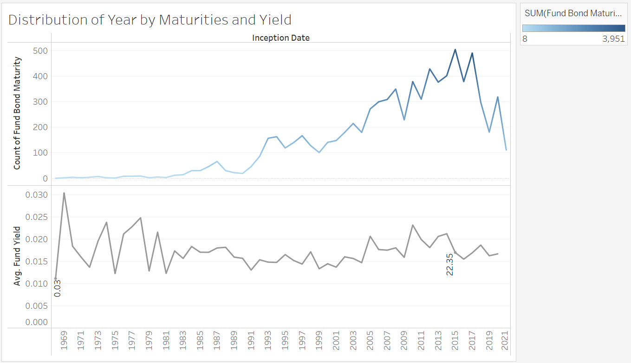
Project analysis slide 5
Visualization Design
And Development
Commencement and Maturity Trends
2015: Highest, with 505 funds maturing.
*Average Yield Trends:
1968: Lowest at 0.03%
2015: Highest at 22.35%.
Financial Implication
Understanding the trends in fund commencement and maturity provides insights into the dynamics of the mutual fund landscape.
The highest average yield in period indicates a potential for favorable returns during that period.
Investors can use the information to align their investment strategies with years that show higher average yields, potentially maximizing returns.

Slide 9
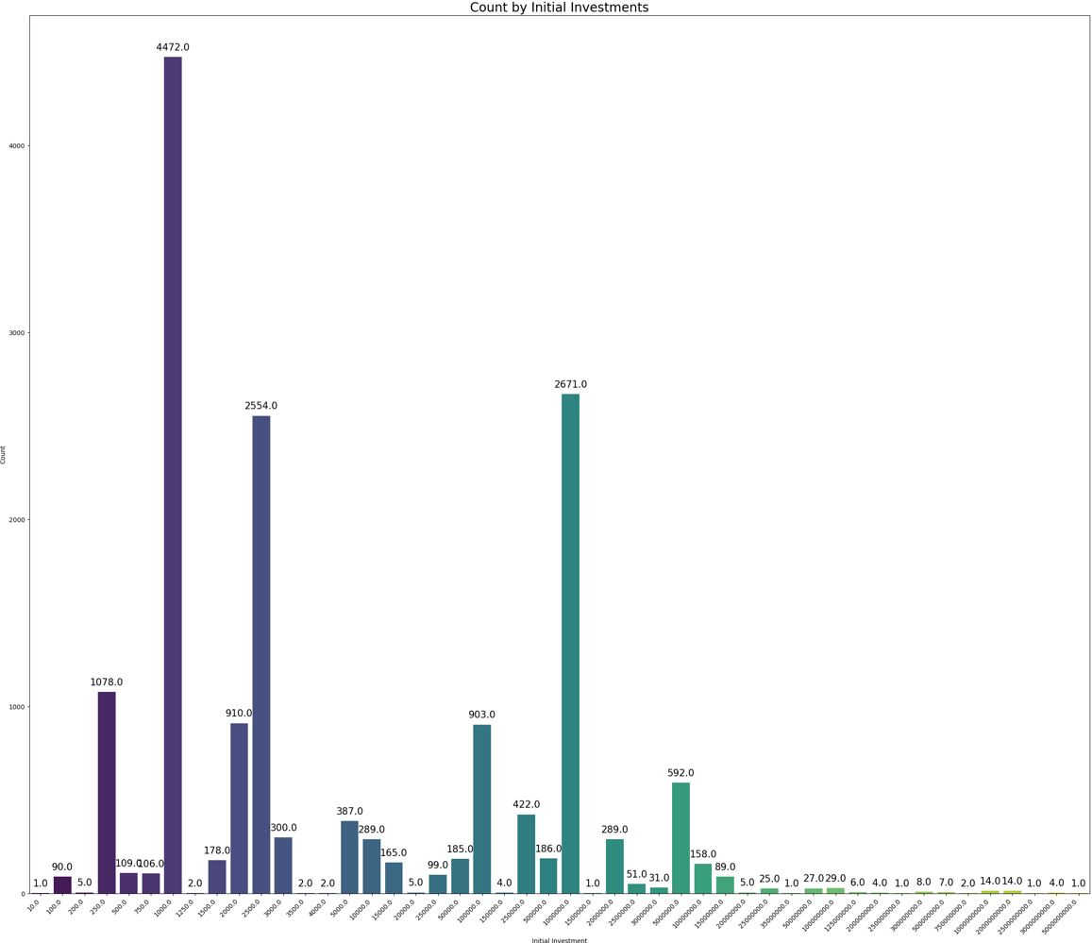
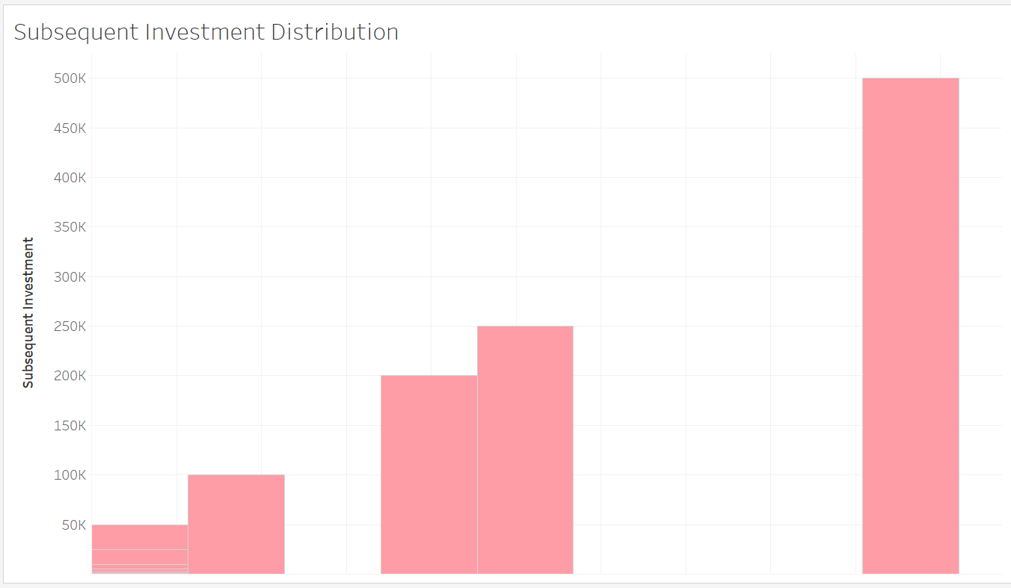
Project analysis slide 5
Visualization Design
And Development
Distribution of Initial Investments
Distribution of Initial Investments
Minimum: $10, Maximum: $5 Billion.
Common Initial Investments: $1,000 (Most recurring), $2,500, $1 Million.
Least Common Initial Investments: $5 Billion, $2.5 Billion, $250 Million.
Financial Implication
Diverse Initial Investments: Demands strategic planning for investors to optimize their portfolio.
Recognizing Common and Uncommon Investments:: Aids potential investors in understanding the spectrum of investment options available.
Minimum: $0, Maximum: $500k
Common Initial Investments: $0 (Most recurring) and below $50k
Least Common Initial Investments: $500k

Slide 10
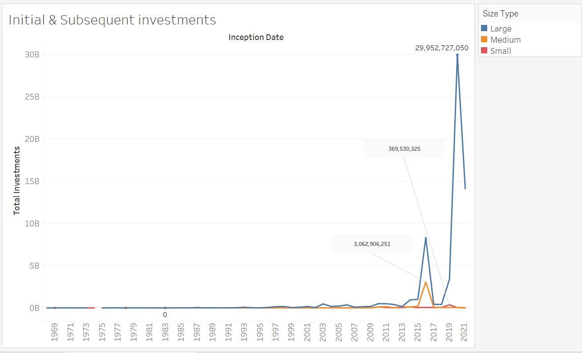
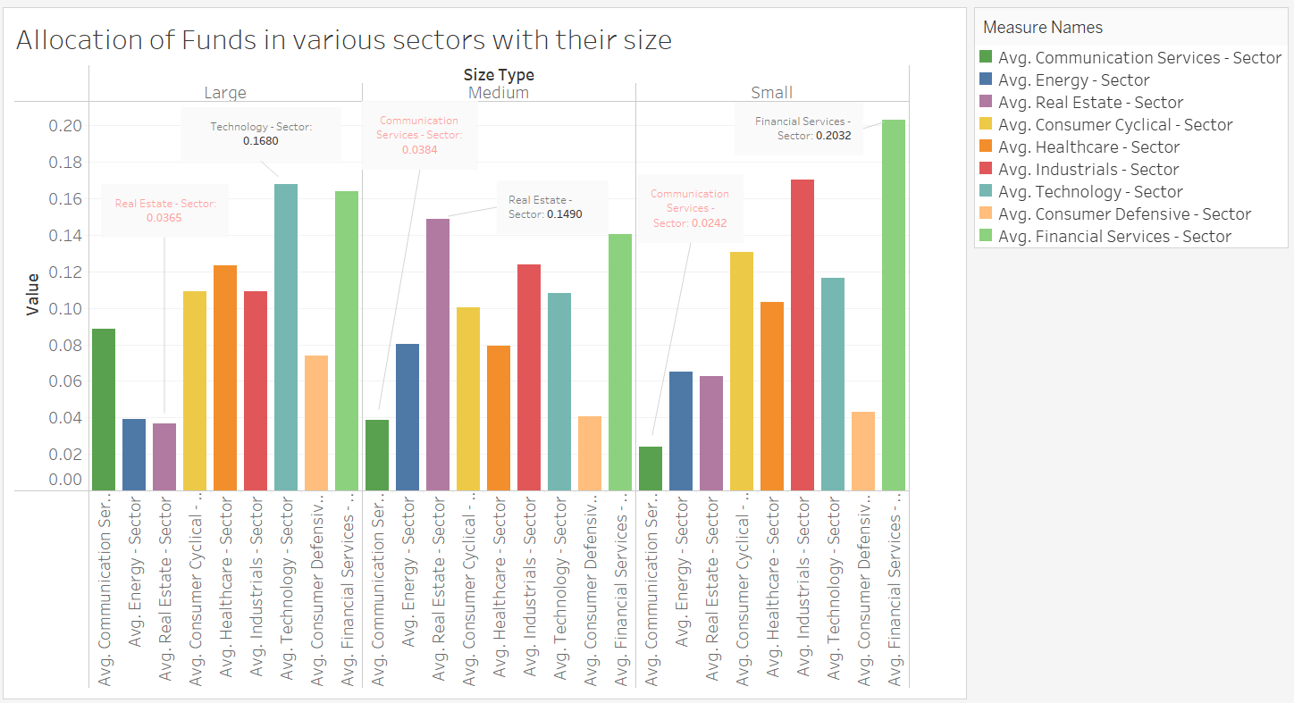
Project analysis slide 5
Visualization Design
And Development
Size-wise Distribution and Allocations of Total Investments"
Mid Size:
Top Sector: Real Estate.
Least Sector: Communication Services
Large Size:
Top Sector: Technology.
Least Sector: Real Estate.
Overall, large-sized fund dominate through the years.
Nonetheless, within each size the sectoral allocations seem to follow certain trends;
Small Size:
Top Sector: Financial Sector.
Least Sector: Communication Services

Slide 11
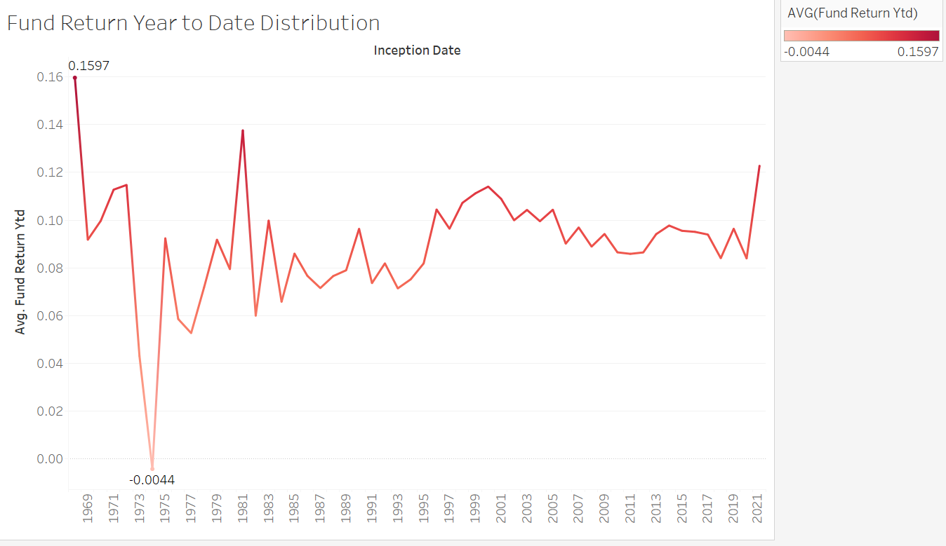
Project analysis slide 5
Visualization Design
And Development
ROI and Volatility Trends
Financial Implication
ROI Fluctuations:
Fluctuations in Return on Investment (ROI) suggest a dynamic and evolving market environment.
Rapid changes in ROI indicate potential market shifts and uncertainties.
Reduced Volatility:
Market Stabilization: Decreased volatility implies a potential trend towards market stabilization.
Investor Confidence: Reduced fluctuations may enhance investor confidence in the market's stability and predictability.
Early Years (e.g., 1974): Highest at 25.27%, lowest at -0.44%.
Recent Years: Reduced volatility in ROI.

Slide 12
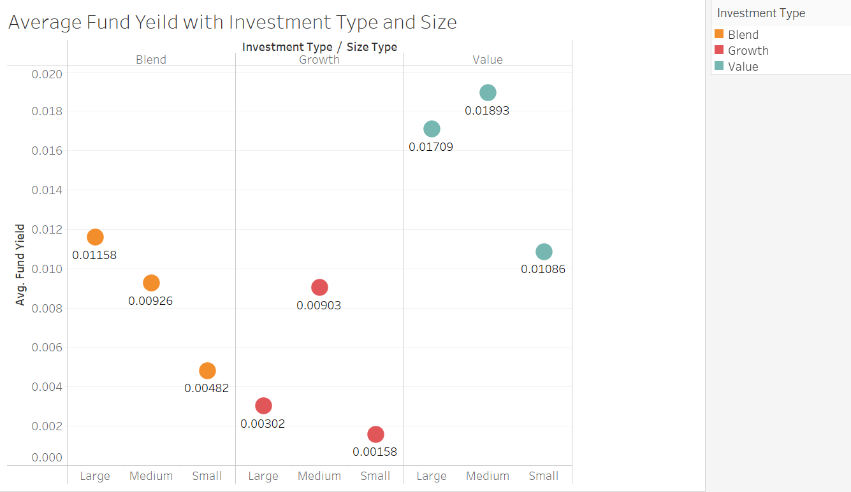
Project analysis slide 5
Visualization Design
And Development
Average Fund Yield Across Investment Types and Size Categories
Yield Trends
Growth Funds:
Small Size: Least Average Yield at 0.158%.
Medium Size: Peaked overall yield within Growth at 0.903%.
Blend Funds: Direct Relationship with Size.
Value Funds:
Medium Size: Highest overall yield at 1.893%.
Small Size: Least Average Yield.
Investment Types: Value, Growth, Blend.
Size Categories: Large, Medium, Small.

Slide 13
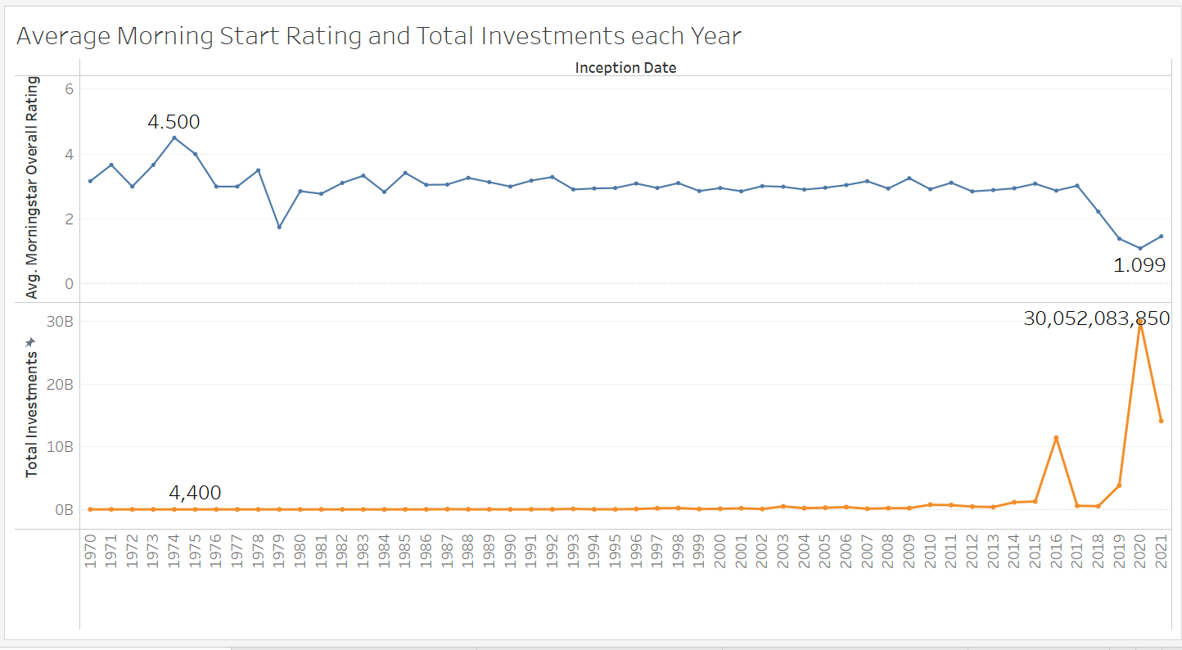
Project analysis slide 5
Visualization Design
And Development
Morningstar Ratings
Morningstar Overall Ratings:
Highest Rating: 1975, with a Morningstar overall average rating of 4.50 out of 5.
Lowest Rating: 2020, at 1.099 out of 5.
Investment Amount Trends:
Lowest Total Investment: 1994, at $4,400.
Lowest Overall Rating Year (2020): Highest total investment, holding $30,052,083,850
Financial Implication
Historical rating highs and lows provide context for fund performance. 2020's lowest rating may suggest challenges or changes in the investment landscape.
Discrepancy in 1994 and 2020 highlights the non-linear relationship between ratings and investment amounts.

Slide 14
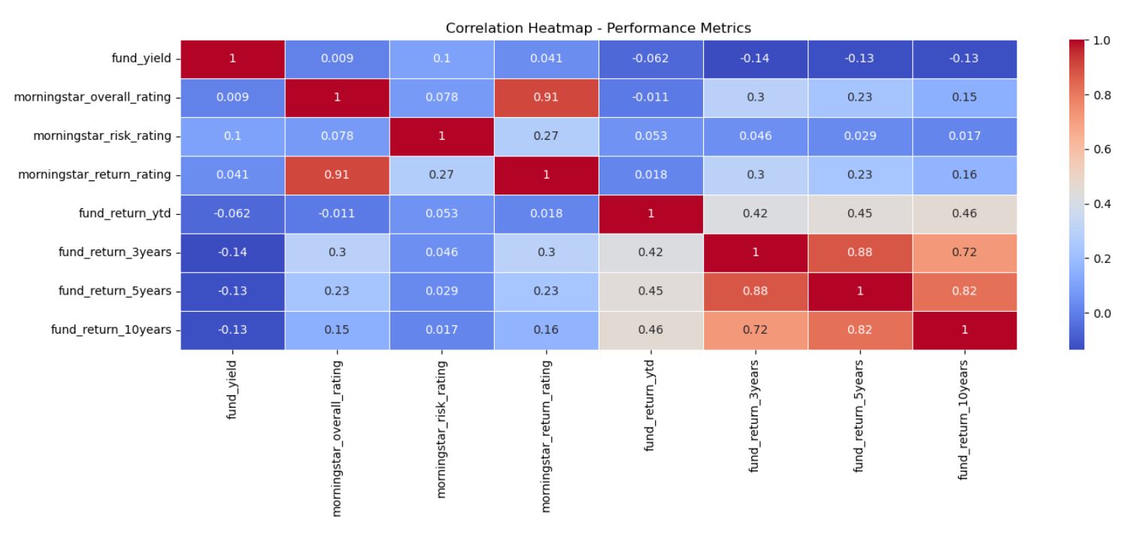
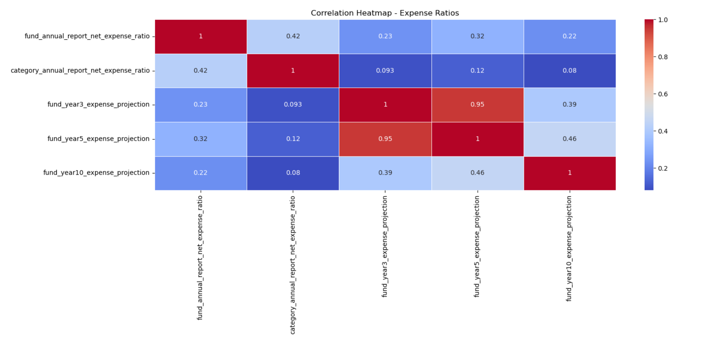
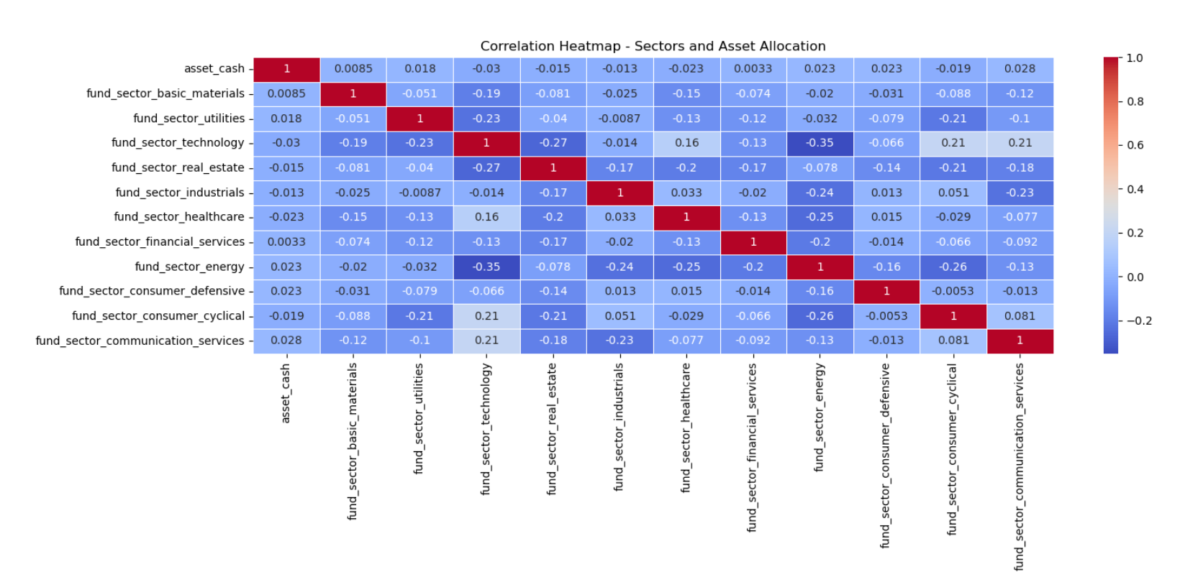
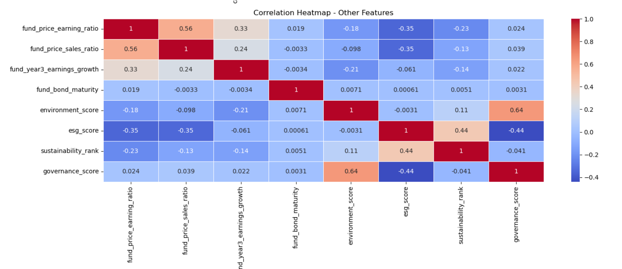
Project analysis slide 5
Visualization Design
And Development

Slide 15



Project analysis slide 5
Model Development
And Testing

Slide 16
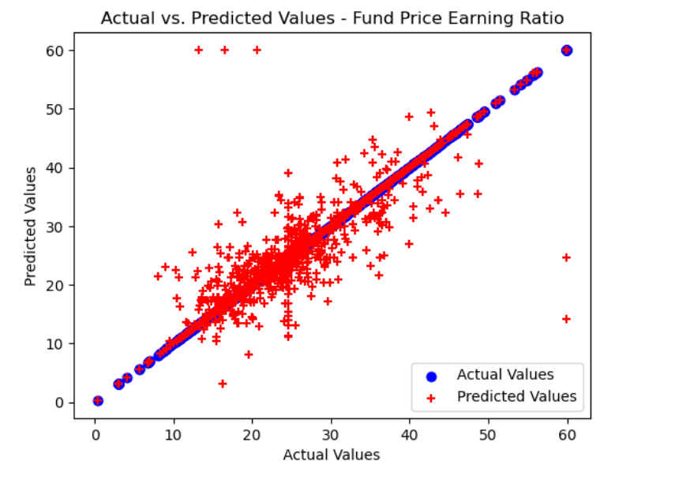
Project analysis slide 5
Model Development
And Testing

Slide 17
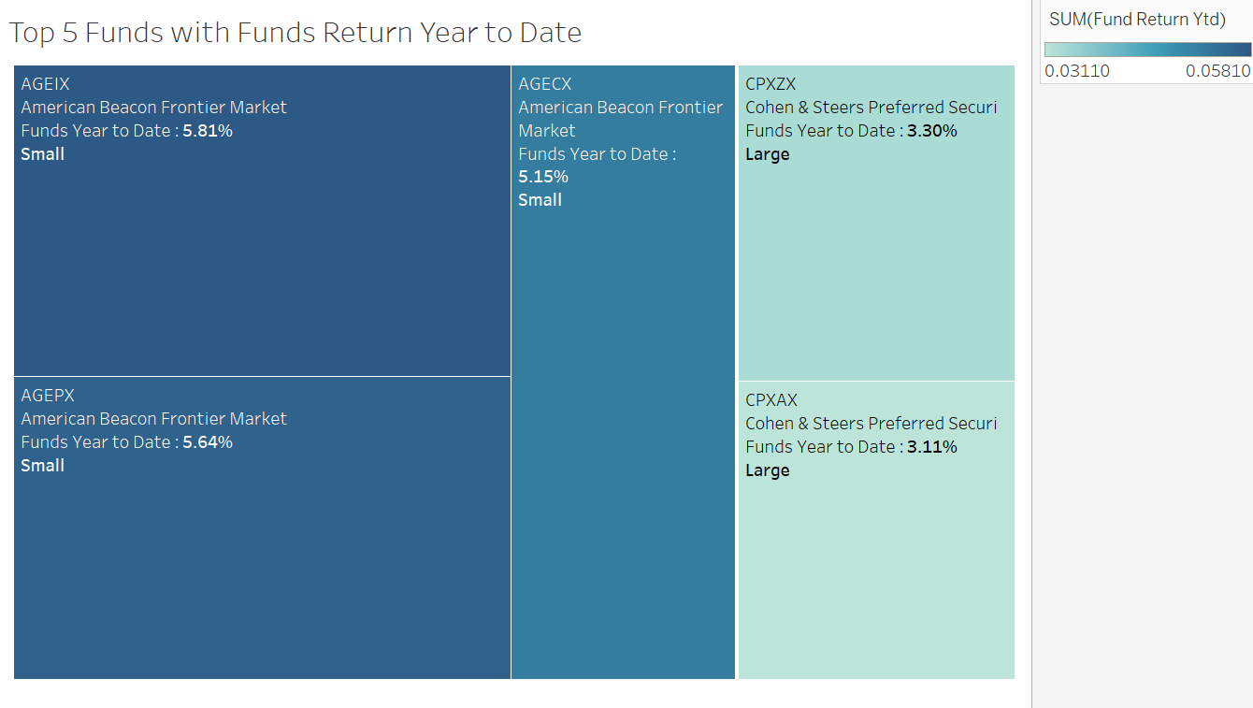
Project analysis slide 5
Fund Classification
Top 5 Funds
Top Performer: AGEIX - Return Ratio: 0.05810%.
Least Performer: CPXAX.
American Beacon Fund Family (Small Size): 1st, 2nd, 3rd: Top performers.
Cohen & Steers Fund Family (Small Size): 4th, 5th: Top performers.
Implications:
American Beacon Fund Family: Dominates top positions in small-sized funds.
Cohen & Steers Fund Family: Represents strong performance within its family and fund size.

Slide 18
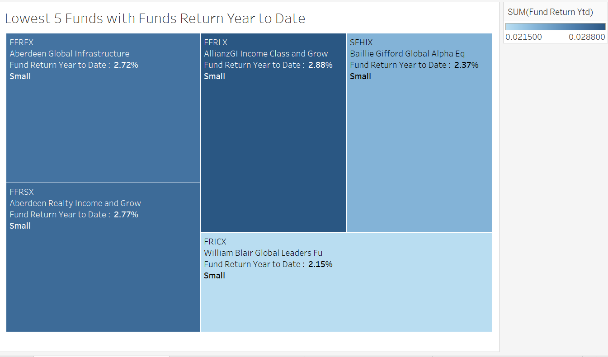
Project analysis slide 5
Fund Classification
Top 5 Funds
Top Lagger: FFRLX (Virtus Family).
Last Position: FRICX (William Blair).
Aberdeen Family: 2nd and 3rd positions in the bottom performers.
Size Category: All funds in the bottom 5 are small-sized
Implications:
Virtus Family (FFRLX): Leads as the bottom performer.
William Blair (FRICX): Holds the last position among the bottom performers.
Aberdeen Family: Represents poor performance in the bottom 5

Slide 19
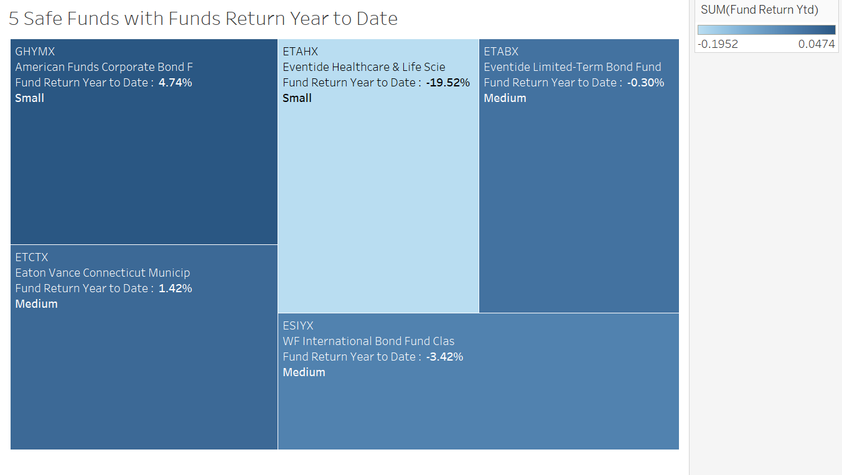
Project analysis slide 5
Fund Classification
Top 5 Funds
Top Performer (Small): GHYMX.
Last Position (Small): ETAHX
Eventide Funds Family: Two out of the five funds in the 'Safe' zone.
Implications:
GHYMX and ETAHX: Represent the extremes within the 'Safe' zone and they are both small-sized funds

Slide 20
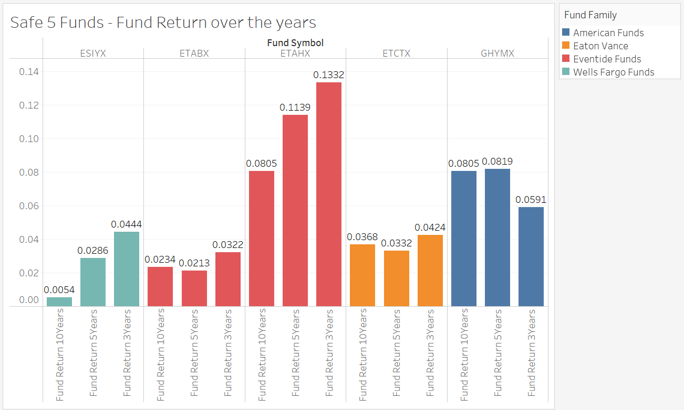
Project analysis slide 5
Visualization Design
And Development
Safe Funds - Historical Returns
Top Safe Funds - Overall Returns (3, 5, 10 Years)
ETAHX (Small-Sized): Dominates with the highest overall returns across all periods.
2. GHYMX (Small-Sized): Follow with strong overall performance.
ETCTX (Medium-Sized): Third-highest overall returns.
ESIYX and ETABX (Medium-Sized): Compete for the fourth and fifth spots alternatively.

Slide 21
Project analysis slide 5
Conclusion And
Reflection
1. Diverse Initial Investments
Initial investments spanned from $10 to $5 Billion.
Common initial investments clustered around $1,000, $2,500, and $1 Million.
Uncommon investments, such as $5 Billion, were minimal.
2. Commencement and Maturity Trends
Trends in fund commencement and maturity highlighted 2015 as a significant year, with 505 funds maturing.
Average yield trends fluctuated, with 1968 witnessing the lowest at 0.03%, and 2015 the highest at 22.35%.
3. ROI and Volatility Trends
Return on investment (ROI) exhibited volatility in earlier years, with recent times showcasing reduced fluctuations.
Notable ROI variations, with 1974 experiencing the highest at 0.2527% and the lowest at -0.0044%.
4. Morningstar Ratings and Investment Trends
Morningstar ratings ranged from historical highs in 1975 to a significant drop in 2020.
Medium-sized funds held the highest rating within and outside their fund type.
Investment amounts varied, with 1994 having the lowest total investment and 2020 holding the largest sum.
5. Avg Fund Yield by Investment Type and Size
Yield variations were observed within different fund types and sizes.
Small-sized Growth funds had the least average yield, while medium-sized Growth funds peaked overall yield.
6. Sectoral Asset Allocation by Fund Size:
Diverse sectoral allocations were witnessed based on fund size.
Financial Services consistently held a significant share of allocated funds across all sizes.
7. Fund Classification - Top and Bottom Performers
Top performers included funds from the American Beacon and Cohen & Steers families, with AGEIX leading.
Bottom performers included FFRLX (Virtus) and FRICX (William Blair), both small-sized funds..
8. Safe Zone - Historical Returns:
ETAHX (Small-sized) emerged as the top performer with the highest overall returns in 3, 5, and 10 years.
GHYMX (Small-sized) and ETCTX (Medium-sized) followed with strong overall returns.

Slide 22

Project analysis slide 5
Strategic Considerations
Risk Management
Assess the implications of investment constraints on fund performance.
Evaluate the potential risks associated with small-sized funds in the bottom performers.
2. Diversification Strategy
Utilize insights for informed sectoral allocation to optimize fund performance.
Consider the performance of these funds for potential inclusion in investment portfolios.
3. Portfolio Optimization
Use information for informed investment decisions and potential portfolio optimization.
Consider the performance of these funds for potential inclusion in investment portfolios.

Slide 23
Thank You

